Slide 1
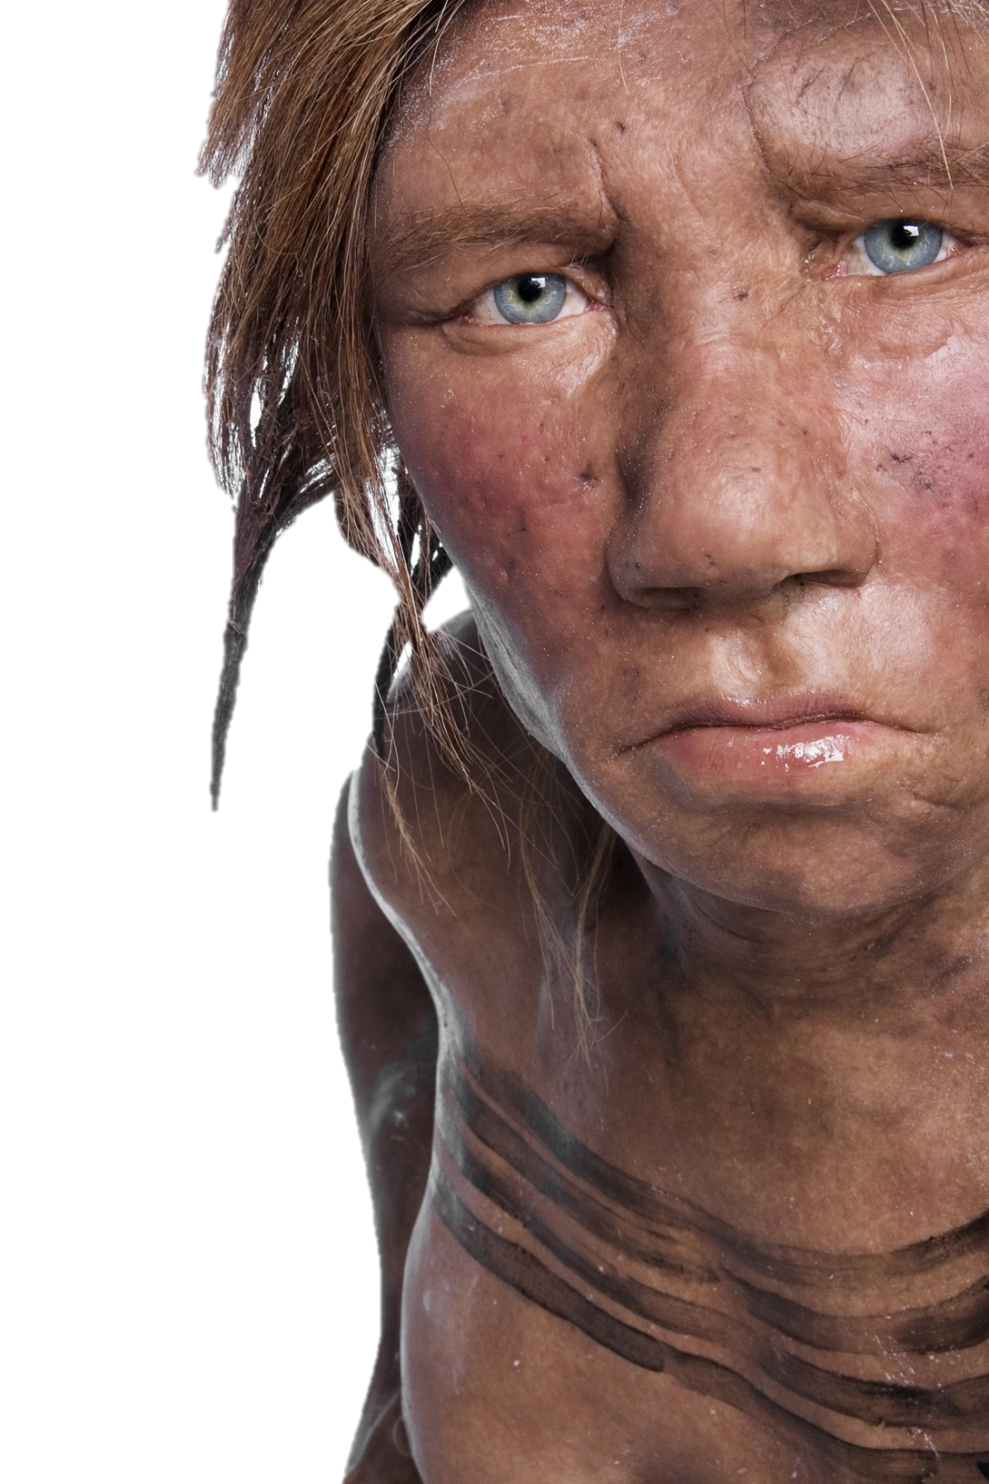
The role of hybridisation in human evolution
Dr Laura T. Buck
Department of Anthropology, Evolutionary Wing
University of California, Davis
lbuck@ucdavis.edu
@_LTBuck
Notes:
Feel free to ask questions during / after class and email
Provided peer-reviewed papers, news articles, blogs (pay attention to your sources…)

Slide 2
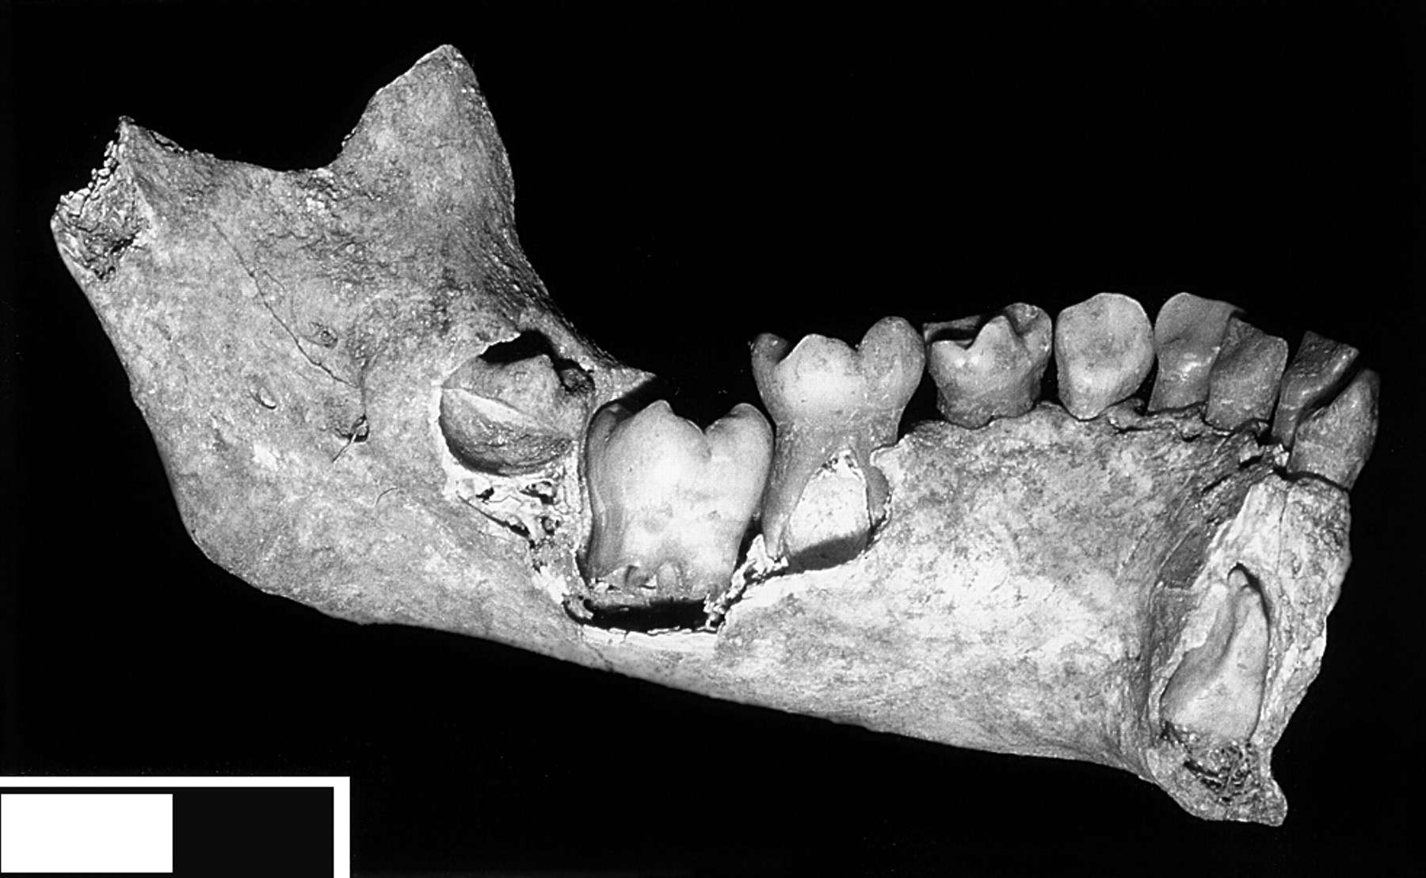
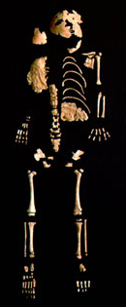
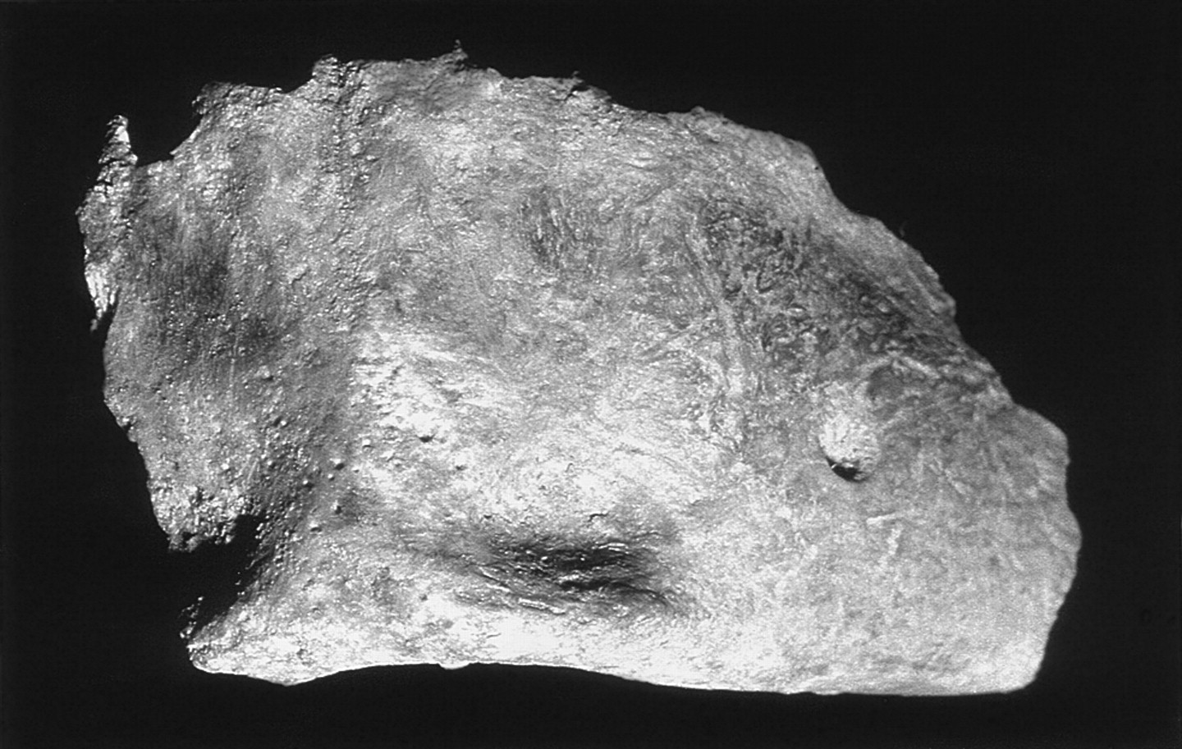
Role of hybridisation in human evolution?
Suggestions of hybrids in fossil records for decades
Debate over human origins
  ‘Out of Africa’ Vs. Multiregionalism
Neanderthal cognitive complexity
Lagar Velho
Portugal, ~25,000 ya
~4 year old child from ritual burial
Mosaic of H. sapiens and Neanderthal features?
“A chunky Gravettian child”
But until recently, no way to be certain…
Lagar Velho 1.
Duarte et al., 1999. PNAS
Notes:
Not suggested to be first generation hybrid – date and subtlety of Neanderthal features
Well-developed chin, but sloping symphysis
Body proportions, diaphyseal dimensions and muscle attachments = Neanderthal like

Slide 3
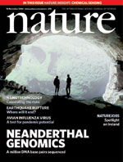
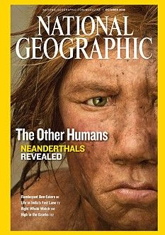
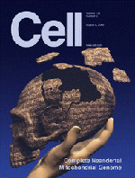
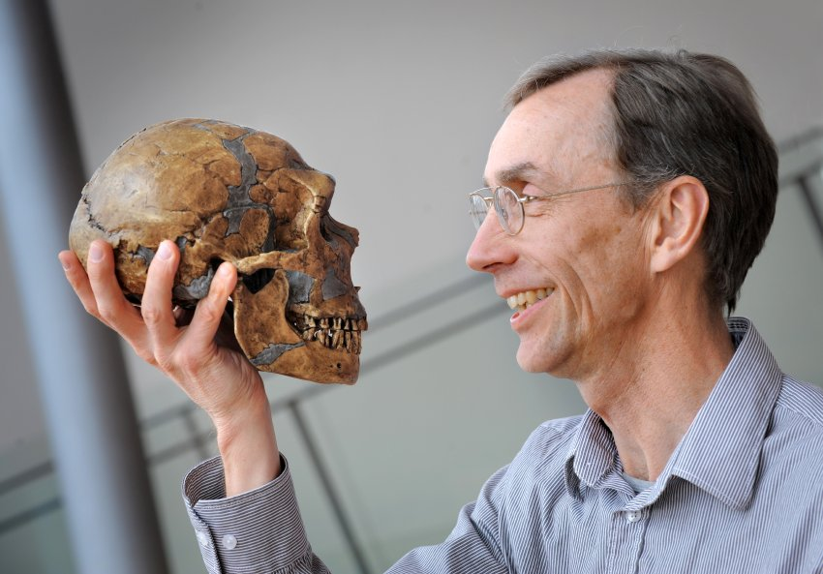
The palaeogenomic revolution
Advances in preventing contamination
Reduction in cost and increase in speed of sequencing
First Neanderthal mtDNA isolated: 1997
Entire human genome sequenced: 2003
Sequencing of Neanderthal genome: 2010
Discovery of Denisovans from aDNA: 2010 (mtDNA initially)
Multiple Neanderthal genomes
Krings, et al. 1997. Cell; IHGSC, 2004. Nature; Green, et al. 2010. Science;
Svante Pääbo, pioneering aDNA reseacher
Notes:
Popular article: www.theguardian.com/science/2014/feb/15/svante-paabo-dna-neanderthal-genetics
Original articles:
Krause, Johannes, et al. "The complete mitochondrial DNA genome of an unknown hominin from southern Siberia." Nature 464.7290 (2010): 894.
Reich, David, et al. "Genetic history of an archaic hominin group from Denisova Cave in Siberia." Nature 468.7327 (2010): 1053.

Slide 4
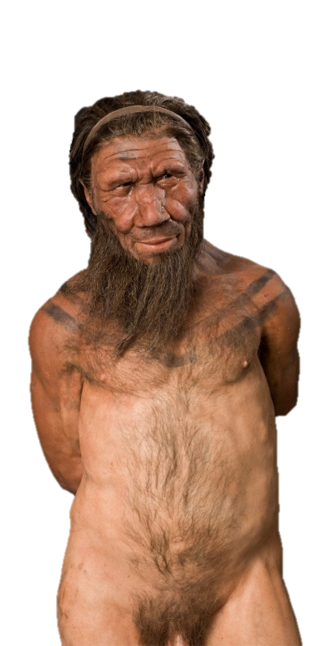
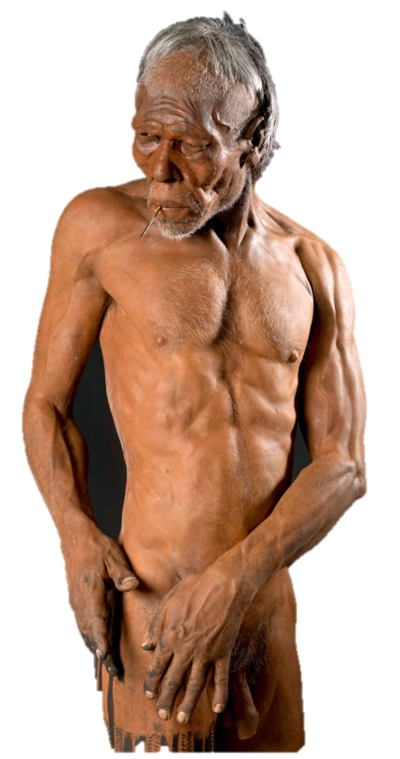
Neanderthals DNA in H. sapiens
Extant non-African humans = ~2% nuclear Neanderthal DNA
  Single mating event?
  Asians and Native Americans > Europeans > Melanesians
No Neanderthal mtDNA in extant humans
  Asymmetrical introgression or drift?
Neanderthal introgression into non-African H. sapiens
  50-60,000 ya?
  Western Asia?
  Europe? – Oase…
Reconstructions based on Spy II (Neanderthal) and Predmosti (Gravettian human) by Kennis & Kennis
Notes:
Popular article: www.sciencenews.org/article/animal-hybrids-may-hold-clues-neandertal-human-interbreeding
First thought same amount of Neanderthal DNA in all non-Africans, therefore probably just one event, but further studies showed different %s and so probably a more complex story
No Neanderthal mtDNA introgression because of asymmetrical matings, or just lost over time (no daughters)?
Not exhaustive list of possible introgression events

Slide 5
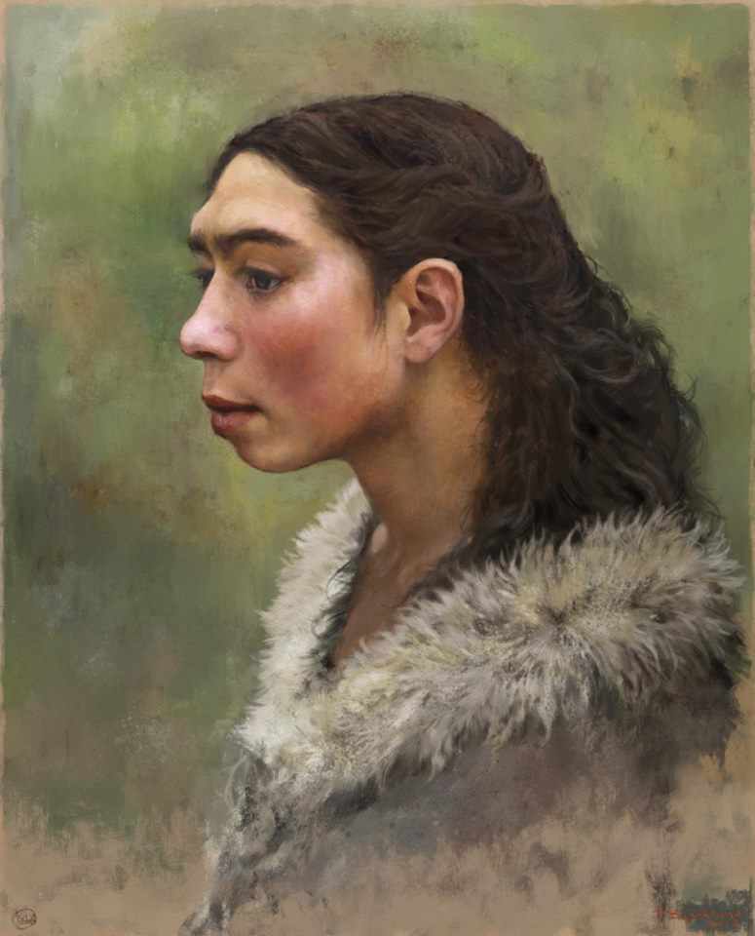
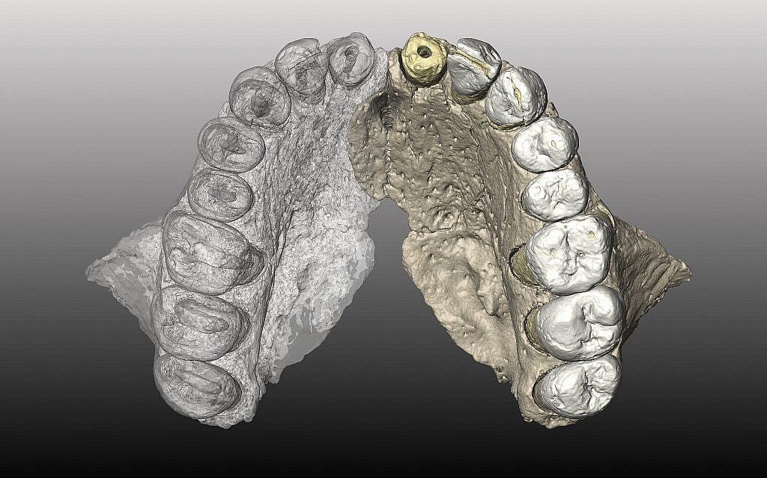
H. sapiens DNA in Neanderthals
Reconstruction of Neanderthal by Tom Björkland
  Lineage including Altai and Vindija (Eastern Neanderthals)
  130-145,000 ya?
  < 2%
  Western Asia – Skhul, Qafzeh, Misliya?
  Long period of overlap / replacement
Misliya, Israel,
H. sapiens, >177,000 ya
Hershkovitz, et al. 2018. Science
Notes:
Popular article: www.sciencenews.org/article/animal-hybrids-may-hold-clues-neandertal-human-interbreeding

Slide 6
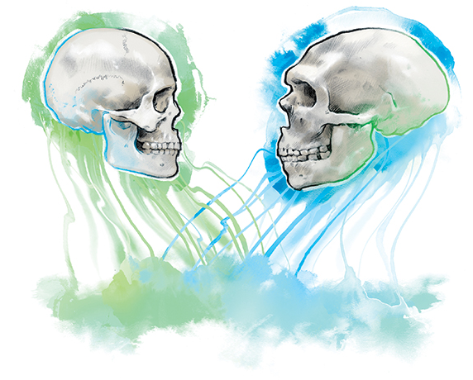
Cost of Neanderthal DNA?
‘Deserts’ lacking Neanderthal genes suggest purging from functional regions (e.g., X chromosome)
  Deleterious – inbred Neanderthals?
  Decline in Neanderthal % over time -> selected against?
  Cost to Neanderthals? Change in environment changed cost / benefit?
Mediated by behaviour?
  X chromosome desert could suggest > M Neanderthal and F human (also mtDNA)
  Mate choice – hybrids not favoured?
Review: Wolf & Akey, 2018. PLoS Genetics.
Notes:
Peer-reviewed article: Wolf & Akey, 2018. Outstanding questions in the study of archaic hominin admixture. PLOS Genetics
Peer-reviewed article: Martin Petr et al. 2019 PNAS
Weakly deleterious in Neanderthals, but very low population density – could accumulate. More easily removed by selection in larger effective population sizes of humans (doesn’t have to be much larger)
1.5 x less Neanderthal DNA than expected on X chromosome
Studies of Ancient Eurasians suggest decline from ~6-2% over ~40 ka
Difficulty with evaluating benefit of introgressed DNA – genes associated with phenotypes today are acting in very different environments to the ones for which they were selected

Slide 7
Functional adaptation through hybridisation?
Tibetan plateau = high altitude
Hypoxia: > 2100m blood O₂ saturation drops
Short-term = altitude sickness
Suppression of reproduction
Archaeology shows humans present at >4000m from 40-30,000 ya in Tibet
Adaptation to hypoxic niche
40-30,000 ya Tibetan lithics.
Zhang et al. 2018, Science
Notes:
Huerta-Sánchez, Emilia, et al. "Altitude adaptation in Tibetans caused by introgression of Denisovan-like DNA." Nature512.7513 (2014): 194.
www.sciencemag.org/news/2014/07/tibetans-inherited-high-altitude-gene-ancient-human
Challenges: cold, radiation, aridity, nutrition
Partial pressure of air drops – less O2 forced into RBCs and some leave lungs with no O2

Slide 8
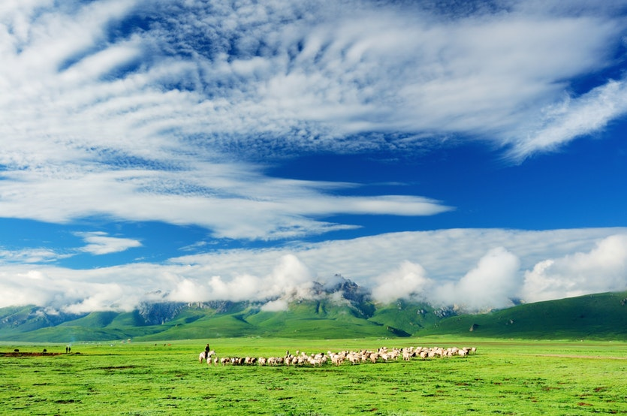
EPAS1 – associated with haemoglobin manufacture
  More efficient O₂ uptake
Extreme positive selection
Very advantageous
Introgression from Denisovans
  Selected haplotype only found in Denisovans and Tibetans
Huerta-Sánchez, et al. 2014 Nature
Notes:
Huerta-Sánchez, Emilia, et al. "Altitude adaptation in Tibetans caused by introgression of Denisovan-like DNA." Nature512.7513 (2014): 194.
www.sciencemag.org/news/2014/07/tibetans-inherited-high-altitude-gene-ancient-human

Slide 9
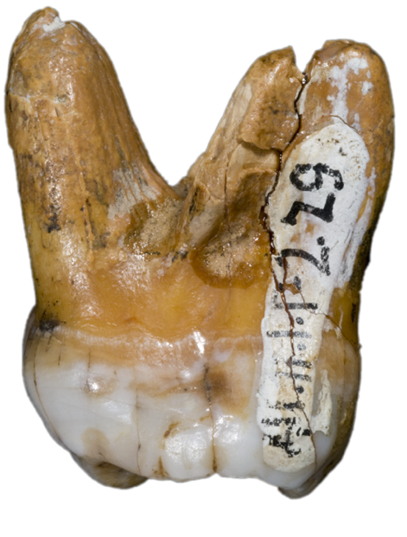
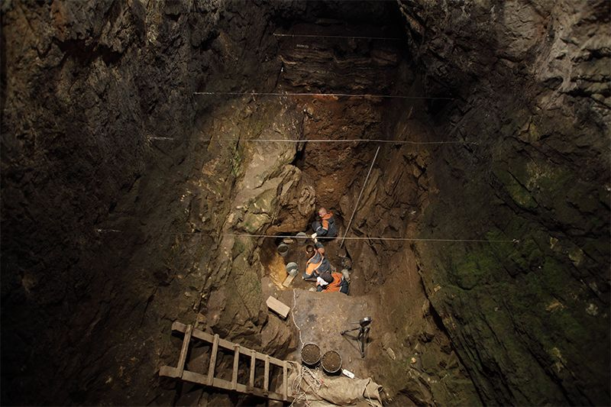
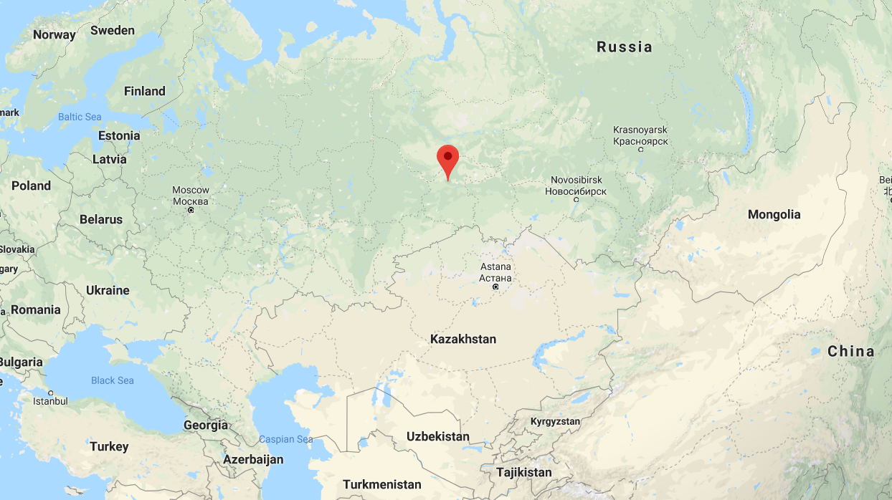
Who were the Denisovans?
Denisova Cave, Siberia
Identified from aDNA, Very few fossils
mtDNA: genetically not H. sapiens, and not Neanderthal
Nuclear DNA: sister species to Neanderthals
4–6% Denisovan DNA in extant Melanesians, lower % in rest of Asia
Denisova Cave
Krause et al. 2010. Nature; Reich, et al. 2010 Nature
Notes:
Denisova isolated outpost at edge of range?
Inbreeding
Edge of area of introgression

Slide 10
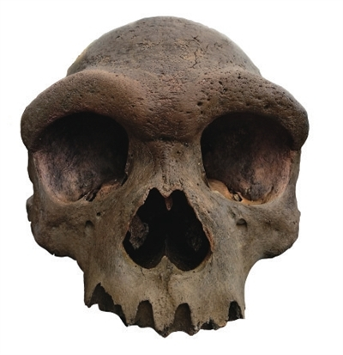
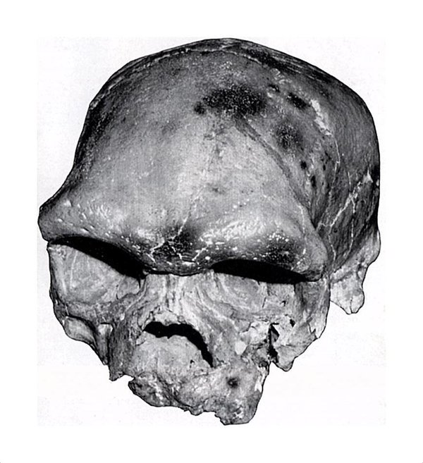
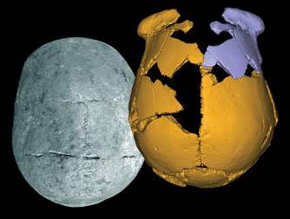
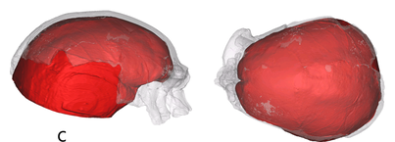
Harbin
China
Some of the Asian material usually classified as H. erectus / heidelbergensis may be Denisovans
We need either
  aDNA matching Denisovans in fossil samples or
  Better fossil evidence from Denisova to compare to more complete fossils
Dali
China
Maba, China
Wu & Bruner, 2016. AJPA
Xuchang, China. Li et al., 2017. Science
Notes:
Xuchang aDNA tested by Q. Fu – unsuccessful
https://www.sciencemag.org/news/2017/03/ancient-skulls-may-belong-elusive-humans-called-denisovans
New parietal fragment –presented by Viola , AAPAs 03.2019

Slide 11
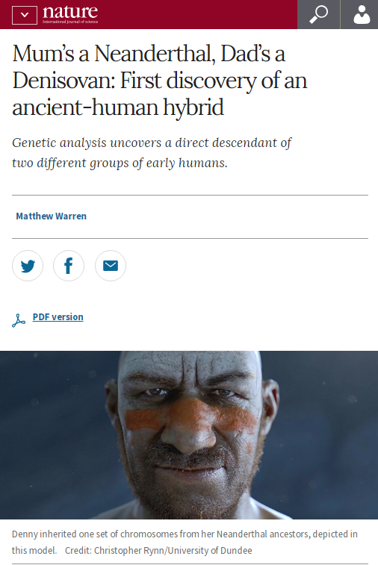
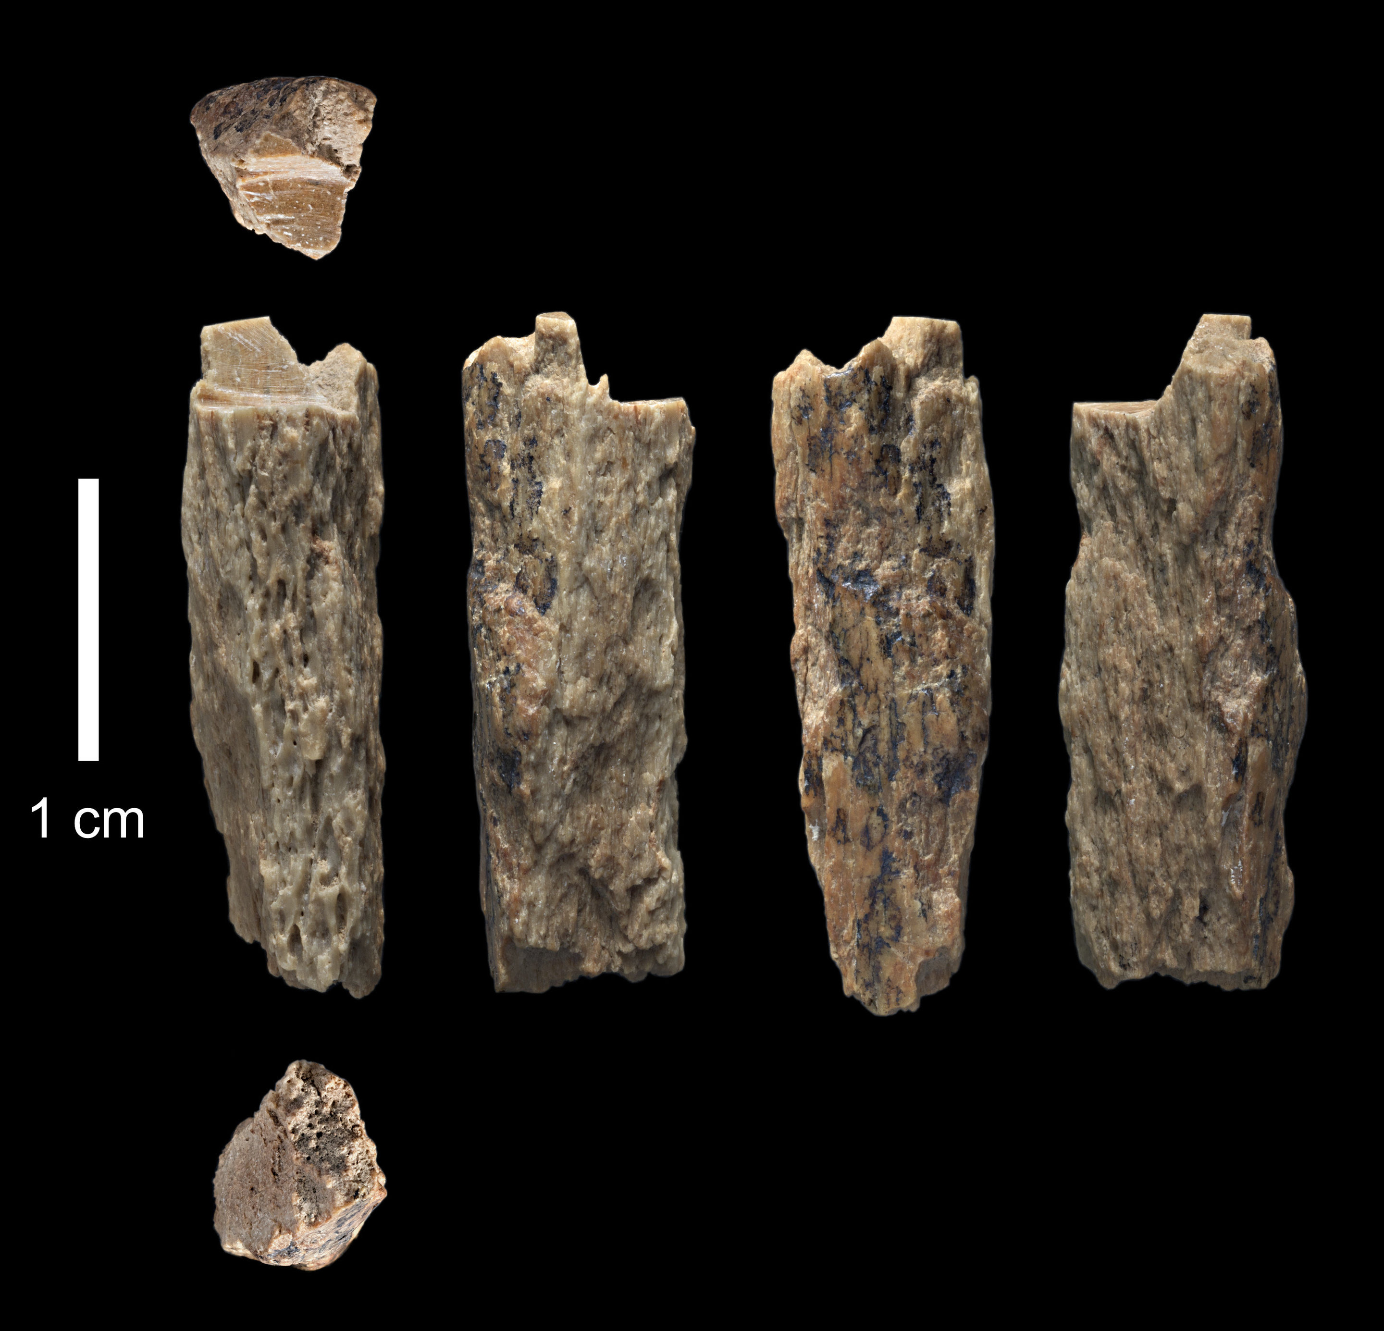
‘Denny’: 1st generation hybrid
  Hominin collagen identified by ZooMS
  ~100,000 ya
  Find = luck or frequency?
  Denisovan father had Neanderthal ancestry
  Implications interactions between species
Slon, et al. 2018. Nature
Notes:
ZooMS breaks collagen, most abundant protein in bone, into smaller peptides -> mass spectrometer to identify differences between animal species. Hominins = identical collagen peptide sequences, so DNA needed for species
Neanderthals, Denisovans and humans all in region at same / similar times
Humans – artefacts @ 43-45 kya (Douka et al.. 2019)
Ust’Ishim

Slide 12
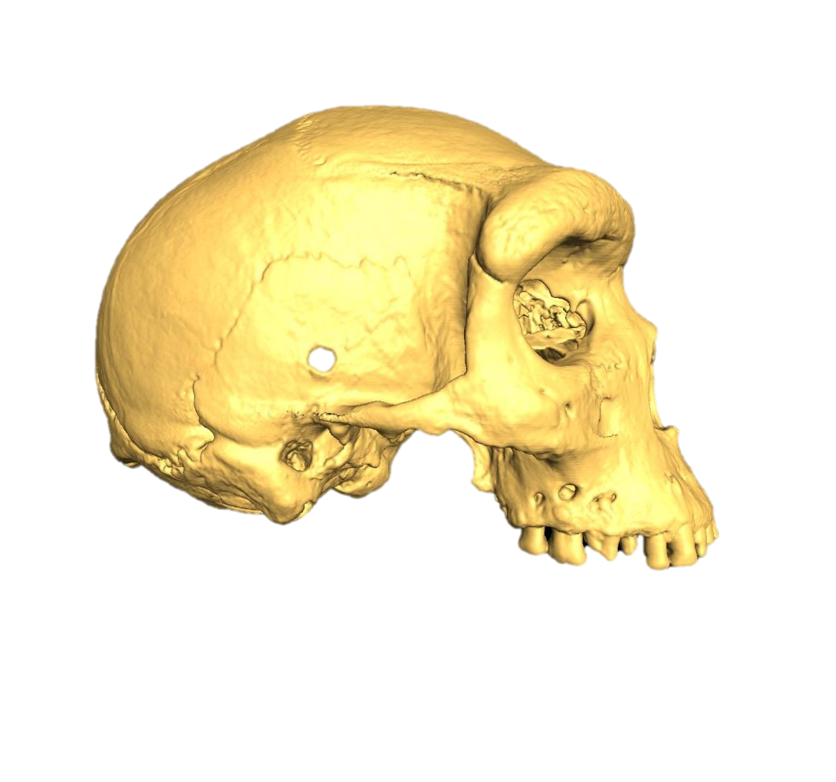
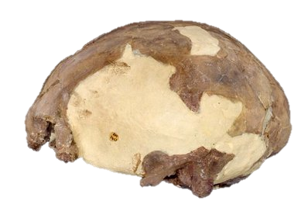
Ghost species – hybridisation in Africa
Historical under-representation in genetic studies
Few fossils from much of Africa (C. and W.)
No reference genomes for extinct African species
Late retention of great morphological variation
Y chromosome coalescence: ~340,000 ya
Modelling suggests introgression
H. heidelbergensis? H. erectus? ...?
Kabwe 1 - H. heidelbergensis. 2-300 kya
Iwo eleru, H. sapiens. ~13 kya
Harvati, et al. 2011. PLoS One; Mendez et al. 2013. Am J Hum Genet; Hammer et al., 2011. PNAS
Notes:
Original article: Mendez FL, Krahn T, Schrack B, et al. An African American paternal lineage adds an extremely ancient root to the human Y chromosome phylogenetic tree. Am J Hum Genet. 2013;92(3):454-9.
Original article: Hammer MF, Woerner AE, Mendez FL, Watkins JC, Wall JD. Genetic evidence for archaic admixture in Africa. Proc Natl Acad Sci U S A. 2011;108(37):15123-8.
Some researchers divide H. erectus into African and Asian material, in which case the African material is designated H. ergaster
Iwo Eleru, Nigera, ~11 – 16 kya. Affinities with much earlier fossils, such as Ngaloba, Skhul & Qafzeh
Kabua, Kenya, likely early Holocene. Primitive traits, such as very thick crania bone and inner ear morphology

Slide 13
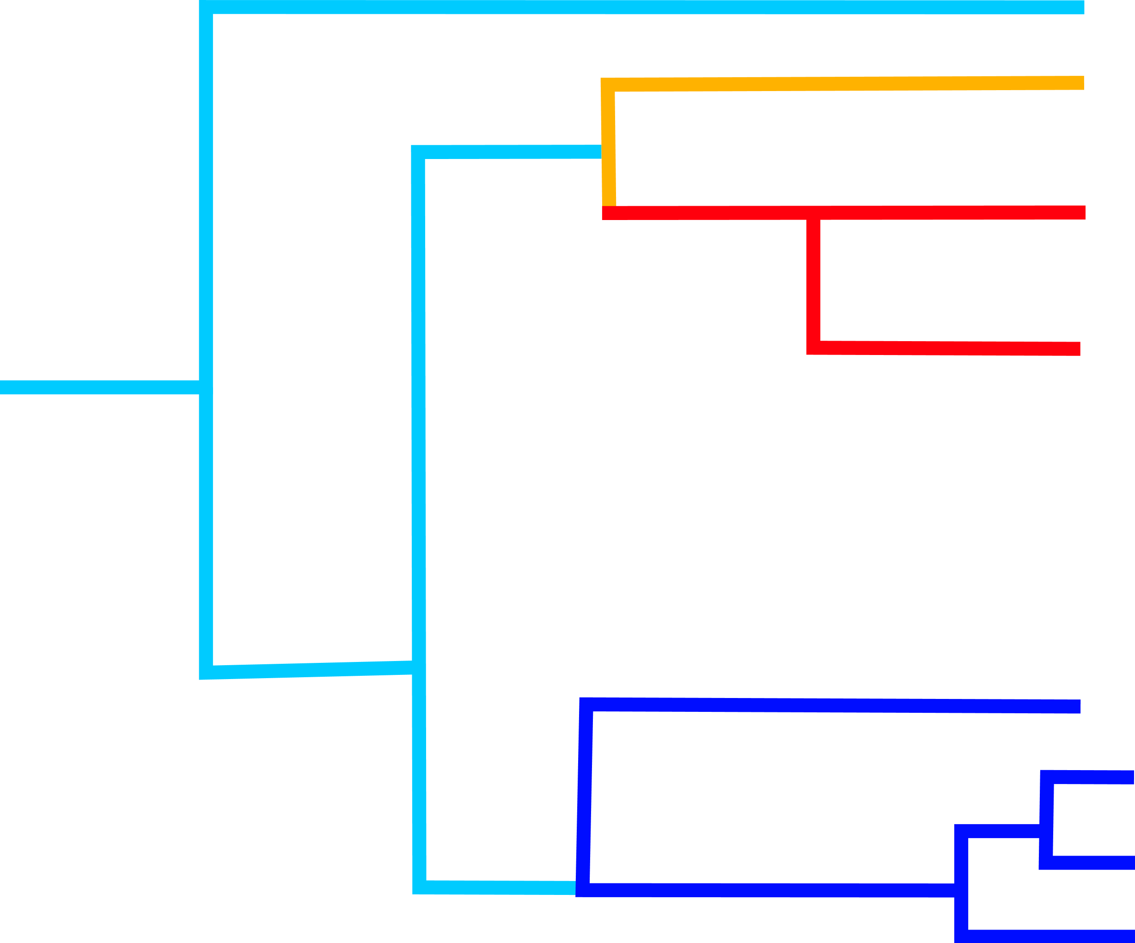
The current picture??
Mystery hominin
Denisovans
E. Neanderthals
W. Neanderthals
Early H. sapiens
Asians / Americans
Europeans
Africans
Notes:
No time dimension, just to give picture of complexity. These are potential interbreeding events, there may be more, some of these may turn out not to have occurred

Slide 14
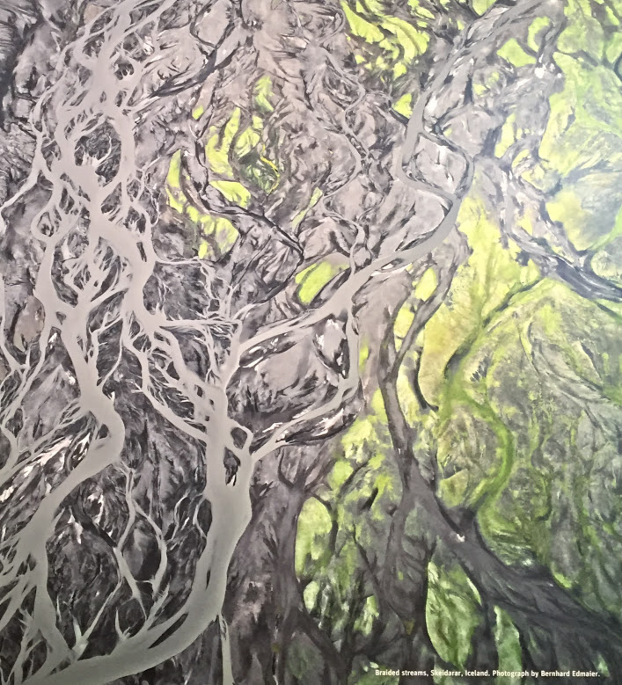
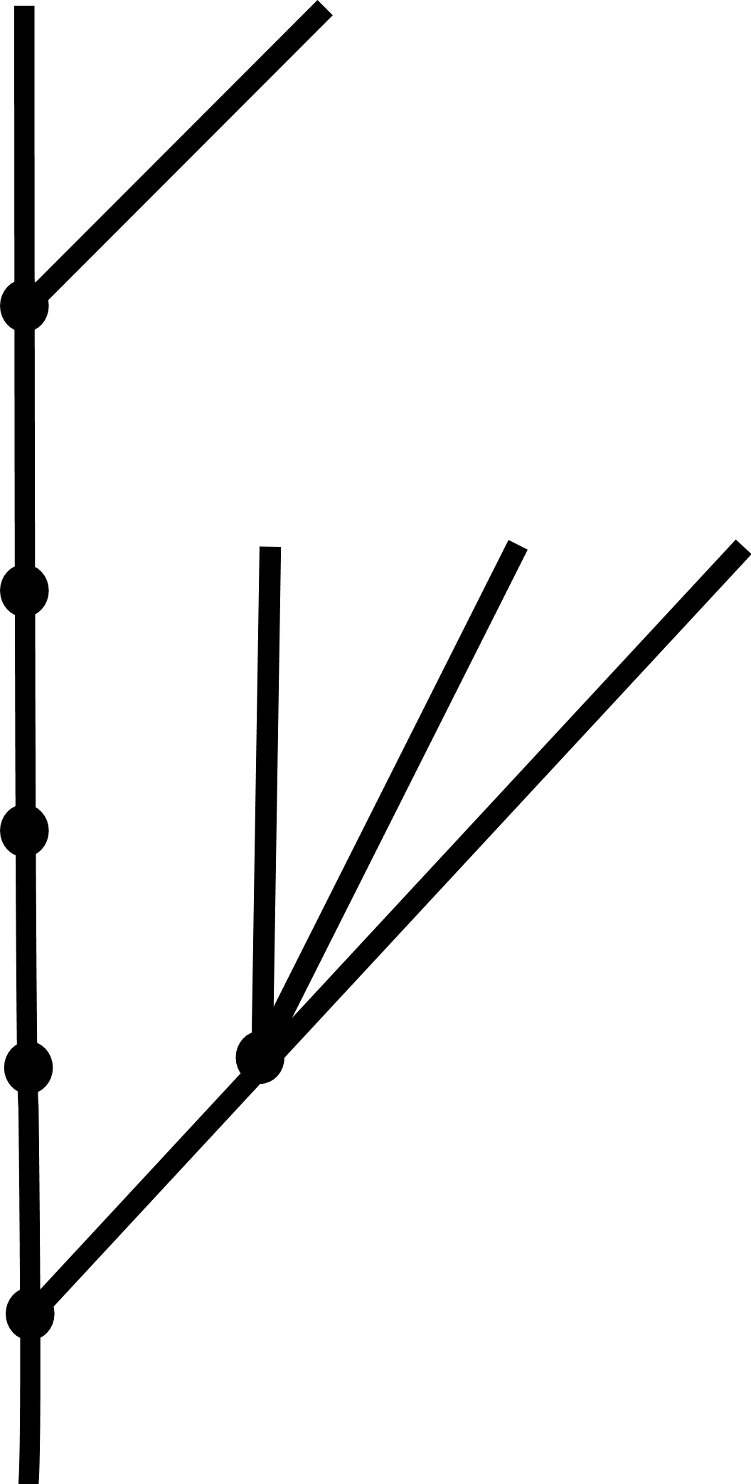
The ‘Braided Stream’ analogy for human evolution
Historical views of hominin phylogeny are oversimplifications
More speciose phylogeny
Hybridisation has been common in human evolution
Notes:
Now not only many more species at every chronological stage and less certainty about links between them, but also evidence for considerable introgression
Probably similar to many other species’ evolutionary histories

Slide 15
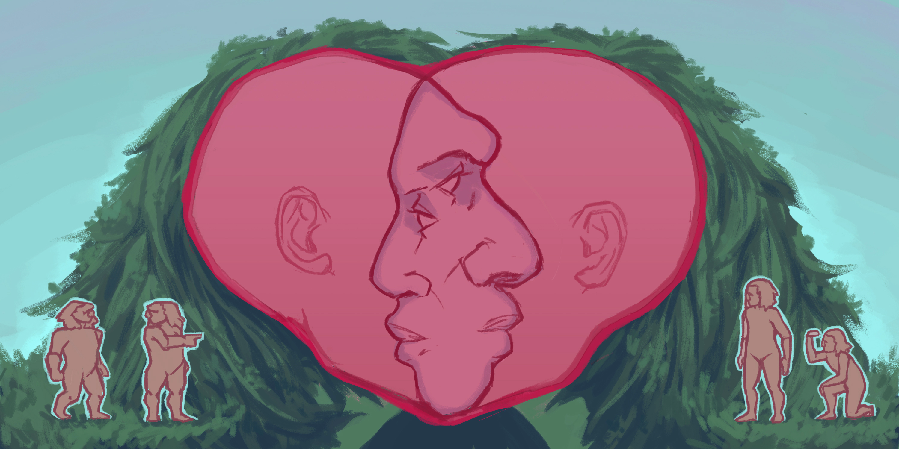
Difficulties in identifying fossil hybrids from morphology
Rarity of aDNA preservation and chronological limit
Sample sizes
Traits of one taxon in seen in another may be hybridisation, retained traits, or convergent / parallel evolution
  Uncertain last common ancestors
Cryptic hybrids / unaffected skeletal phenotypes
Notes:
In the absence of aDNA… (climate, age, contamination)
Convergent is two separate species not sharing a common ancestor evolving similar traits. And parallel evolution is two similar species sharing a common ancestor evolve the same traits independently.

Slide 16
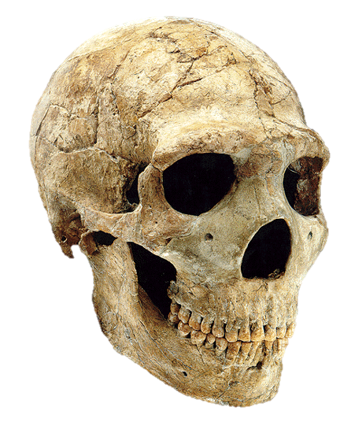
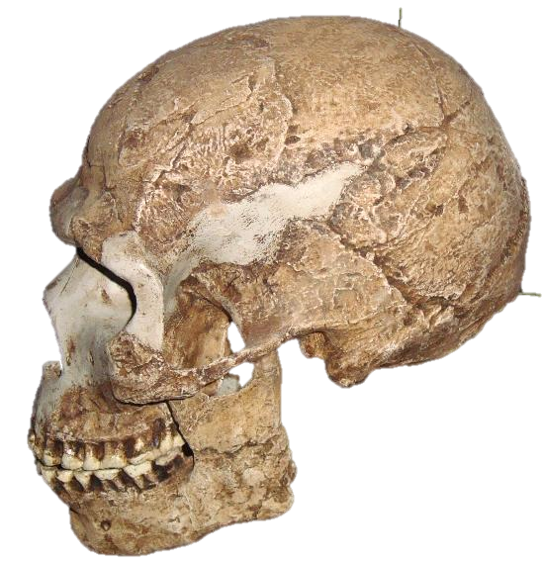
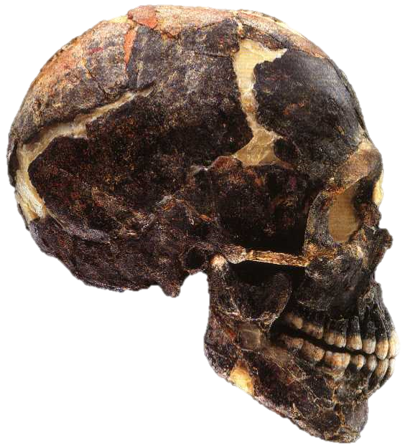
Neanderthal / H. sapiens hybrids?
Amud 1
Qafzeh – H. sapiens
  Mousterian industry
  Lots of variation in size
  Dental anomalies
Skhul – H. sapiens
  When discovered, Neanderthal affinities highlighted
  Retromolar space, chin not well-developed
  Some dental anomalies and high levels of asymmetry
Amud 1 – H. neanderthalensis
  Size
  Dental anomalies – rare reduced maxillary 3rd molar
Skhul 5
Qafzeh 9
Rogers Ackermann, 2010. Evol Anthropol
Notes:
Using Rogers Ackermann, 2010 – info from baboons
Skhul – 130,000 ya, and Qafzeh, 90,000 ya, both Israel, H. sapiens. Both multiple individuals, burials.
Amud 55,000

Slide 17
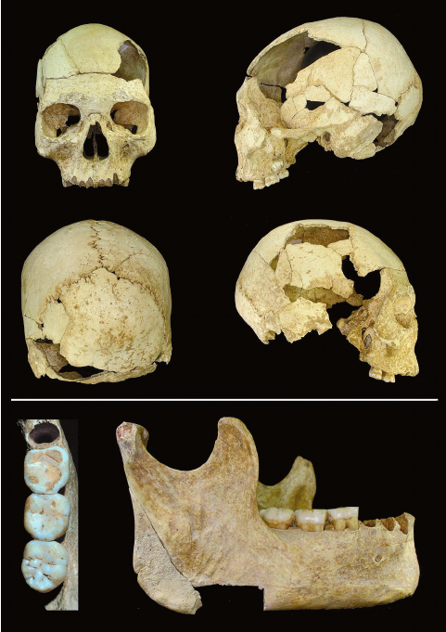
Oase: 4-6th generation hybrid
Oase 2
Peştera cu Oase, Romania, ~40,000 ya
?hybrid morphology:
  Mandible: (primitive) large & robust, wide ramus, large teeth, increasing molar size. (human-like) chin. (Neanderthal) bridging on mental foramen
Mandible – aDNA showed 6-9% Neanderthal
Fragment size indicates recent introgression
Proves hybrid morphology can be diagnosed?
Oase 1, male adult mandible
Fu et al., 2015. Nature; Trinkaus, 2003. PNAS
Notes:
Original article: Fu et al. 2015. Nature, 524: 216
Blog post: Nutcracker Man: An interesting case of hybrid morphology (and genome): the Oase-1 jaw. July 2018
Mandible morphology: Trinkaus, 2003. PNAS 100(20): 11231–11236

Slide 18
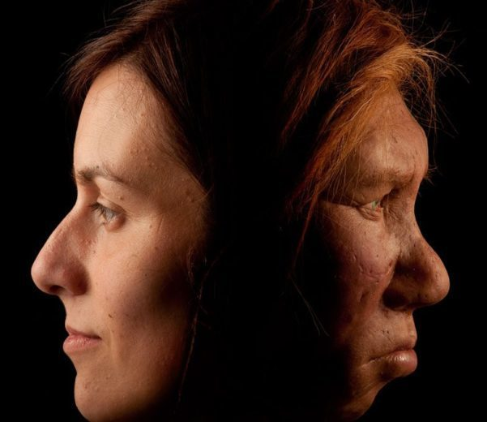
Are humans and Neanderthals different species?
H. sapiens neanderthalensis?
Biological Species Concept
Many widely accepted species hybridise
Similar amounts of variation as between other well accepted species
If species do not completely reflect biological reality, their purpose is to usefully categorise
Combining H. sapiens and Neanderthals results in a morphologically useless species diagnosis
Notes:
Comparable variation to between chimpanzees and bonobos
Globular neurocranium and long, low cranium. Small, flat face and large, projecting face. Small browridges and large browridges…
Strict interpretation of the BSC not widely applied these days
Stringer & Buck, 2014. Diagnosing Homo sapiens in the fossil record. Annals of Human Biology 41: 312-322
Stringer C. 2016 The origin and evolution of Homo sapiens. Phil. Trans. R. Soc. B 371: 20150237

Slide 19
Useful readings
Peer-reviewed articles
Krause, Johannes, et al. "The complete mitochondrial DNA genome of an unknown hominin from southern Siberia." Nature 464.7290 (2010): 894.
Reich, David, et al. "Genetic history of an archaic hominin group from Denisova Cave in Siberia." Nature 468.7327 (2010): 1053.
Wolf & Akey, 2018. Outstanding questions in the study of archaic hominin admixture. PLOS Genetics
Huerta-Sánchez, Emilia, et al. "Altitude adaptation in Tibetans caused by introgression of Denisovan-like DNA." Nature 512.7513 (2014): 194.
Mendez FL, Krahn T, Schrack B, et al. An African American paternal lineage adds an extremely ancient root to the human Y chromosome phylogenetic tree. Am J Hum Genet. 2013;92(3):454-9.
Hammer MF, Woerner AE, Mendez FL, Watkins JC, Wall JD. Genetic evidence for archaic admixture in Africa. Proc Natl Acad Sci U S A. 2011;108(37):15123-8.
Fu et al. 2015. Nature, 524: 216 (Oase aDNA)
Stringer & Buck, 2014. Diagnosing Homo sapiens in the fossil record. Annals of Human Biology 41: 312-322
Stringer C. 2016 The origin and evolution of Homo sapiens. Phil. Trans. R. Soc. B 371: 20150237
Popular articles
news.nationalgeographic.com/news/2013/12/131218-neanderthal-genome-incest-archaic-ancestor-science/
www.sapiens.org/column/animalia/human-origins-and-animal-hybrids/
www.theguardian.com/science/2014/feb/15/svante-paabo-dna-neanderthal-genetics
www.sciencemag.org/news/2014/07/tibetans-inherited-high-altitude-gene-ancient-human
https://www.sciencemag.org/news/2017/03/ancient-skulls-may-belong-elusive-humans-called-denisovans
www.sciencenews.org/article/animal-hybrids-may-hold-clues-neandertal-human-interbreeding
www.sciencedaily.com/releases/2008/09/080908203013.htm

