Slide 1
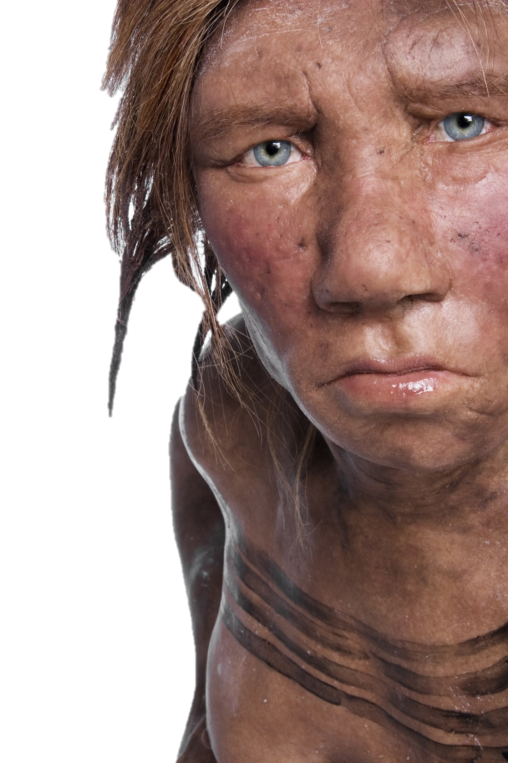
The role of hybridisation in evolution
Dr Laura T. Buck
Department of Anthropology, Evolutionary Wing
University of California, Davis
lbuck@ucdavis.edu
@_LTBuck
Notes:
Feel free to ask questions during / after class and email
Provided peer-reviewed papers, news articles, blogs (pay attention to your sources…)
Hybridisation in general terms
Break
Hybridisation in human evolution
Current project – preliminary results
Questions and casts

Slide 2
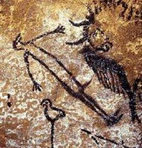
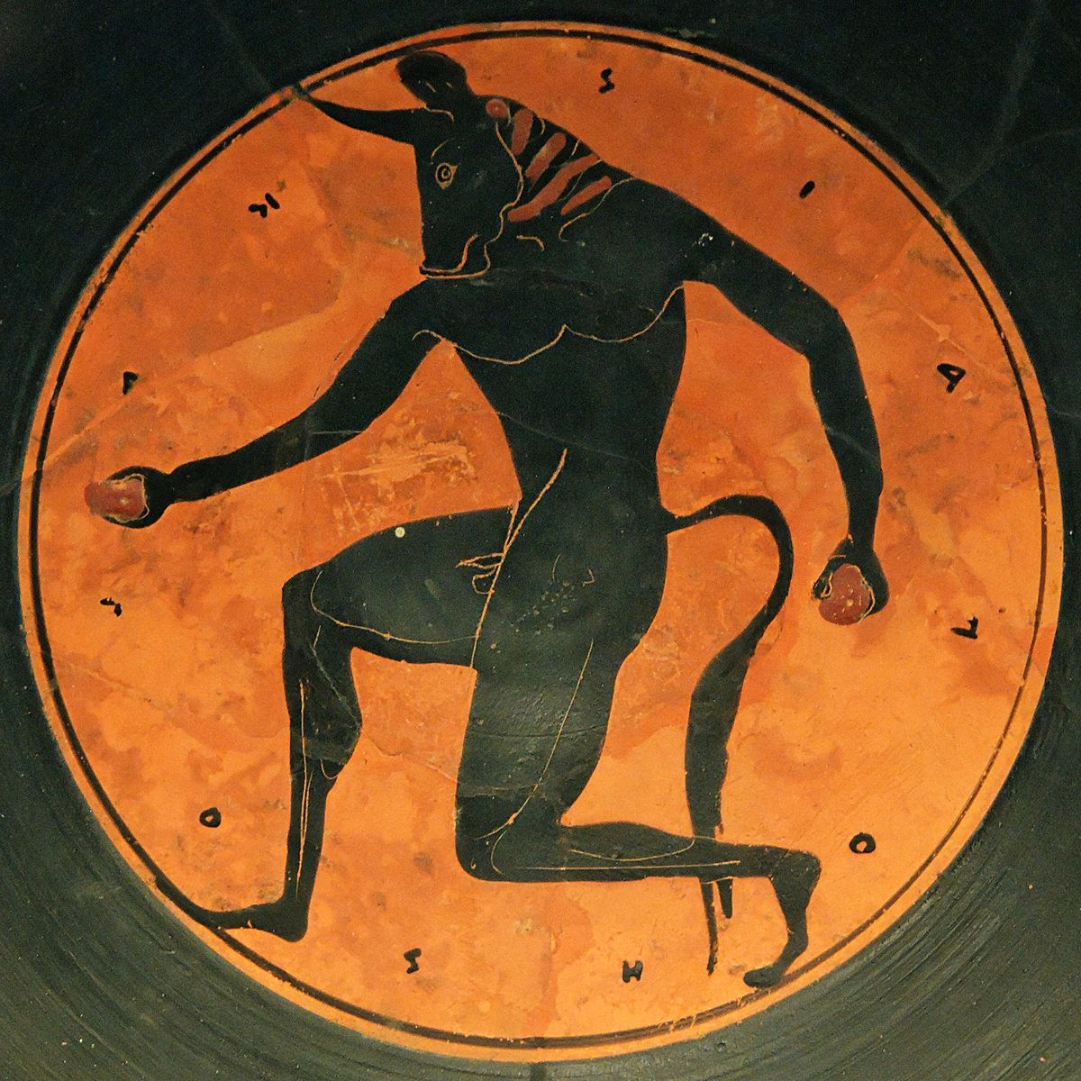
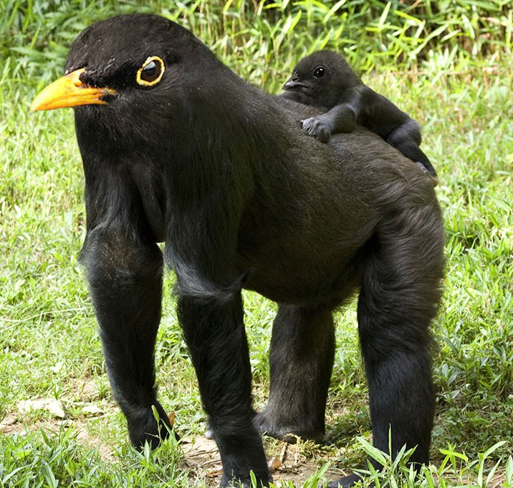
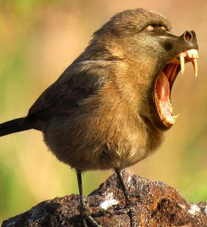
What is hybridisation?
“The process of an animal or plant breeding with an individual of another species or variety”.
Oxford English Dictionary
Notes:
Source of endless fascination… -> obsessed with classification -> something that is neither one thing nor the other
But what IS a hybrid?
In practice the term is not cut and dried, partly because the relevant groups can also be difficult to differentiate…
How do you define a species?

Slide 3
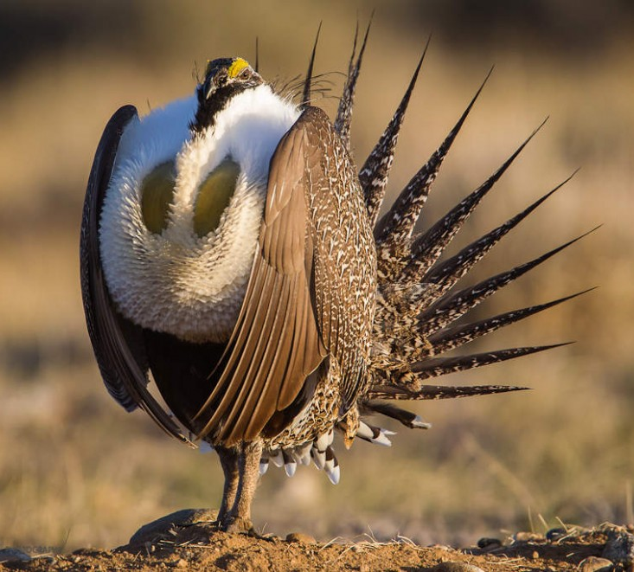
What is a species?
Biological species concept (E. Mayr) – defined by reproductive isolation
Criterion not met for many widely accepted species
Utility for fossils (morphological species concept)
Mating recognition / geographic barriers
Human construct, useful but not necessarily representative of biological reality?
“genetically differentiated lineages…”
Rogers Ackermann, 2010
Notes:
Consideration of hybridisation is inextricably linked to concepts of species. Hybridisation is often defined as occurring between species, yet its existence challenges the validity of many accepted species.
How ‘real’ are species designations?
Meyer – 1940s

Slide 4
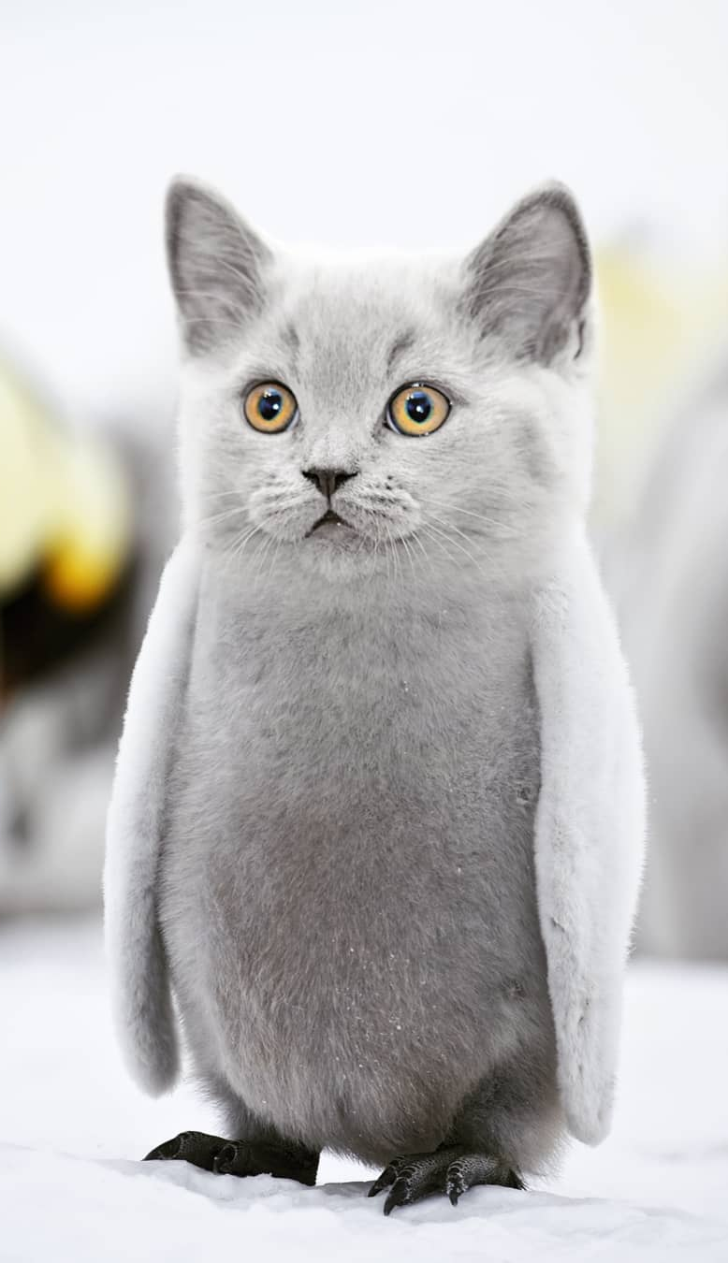
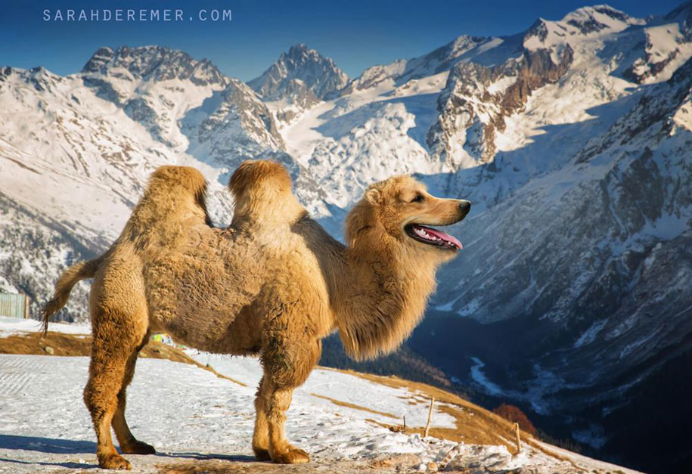
Is hybridisation an important evolutionary mechanism?
Has hybridisation played an important part in human evolution?
Notes:
Importance of hybridisation in evolution long appreciated in Botany, less so in Zoology
More hybrid species being found with better molecular genetic techniques
Popular article: www.nature.com/scitable/topicpage/hybrid-incompatibility-and-speciation-820
Popular article: www.sciencenews.org/article/hybrids-reveal-barriers-successful-mating-between-species

Slide 5
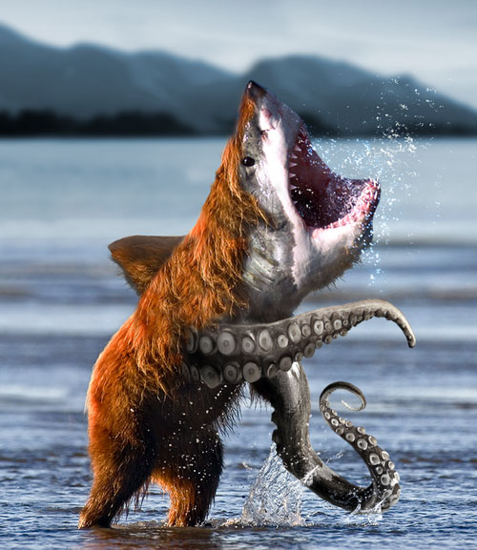
Hybridisation’s role in evolution- reduced fitness
Historical assumption: hybridisation is rare and hybrids are sterile?
Evolutionary dead-ends?
If species are adapted to their niches, intermediates are likely to be less fit
Hybrid zones of decreased fitness
Reinforces separation -> speciation
Hybrids are often less fit in either parent’s habitat, but can be of equal / superior fitness in novel habitats…
Notes:
Peer-reviwed article: Seehausen, 2004. Hybridization and adaptive radiation. Trends in ecology and evolution (TREE): 19: 198-207
Popular article: www.nature.com/scitable/topicpage/hybrid-incompatibility-and-speciation-820
Popular article: www.sciencenews.org/article/hybrids-reveal-barriers-successful-mating-between-species
Even in viable hybrids, there may be a loss in fitness
Historical emphasis on reduced fitness led to underappreciation of role of hybridisation in zoology
Role in speciation due to reinforcing separation also creative

Slide 6
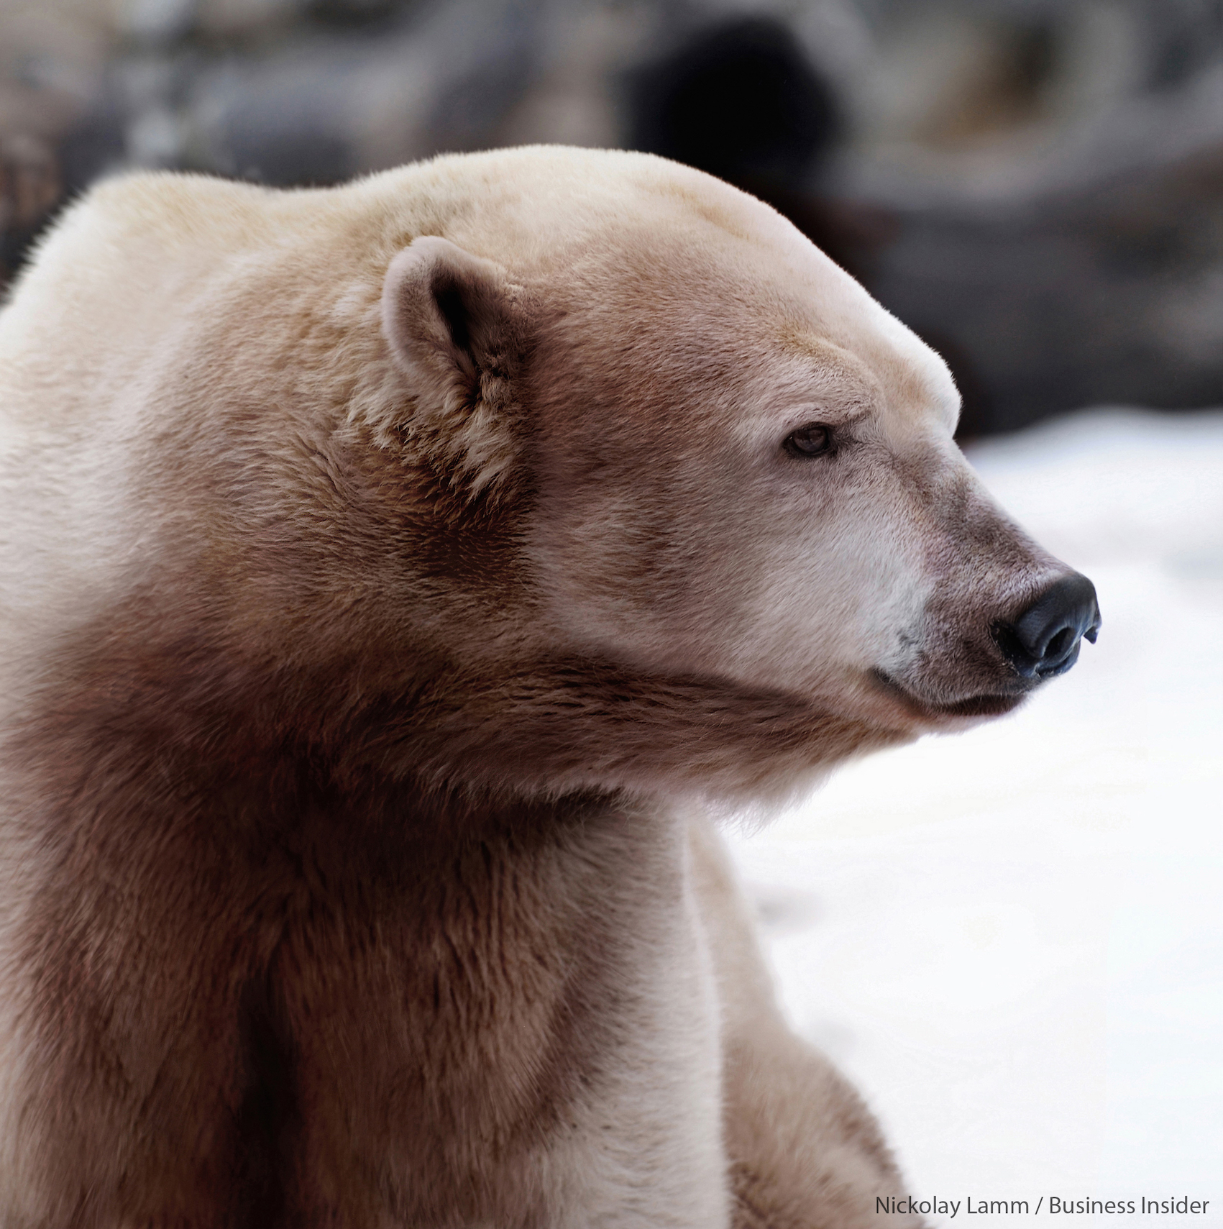
Hybridisation’s role in evolution - source of variation
Variation = raw material of evolution
Immediate source of potentially large-scale variation
Potentially more variation than in parent species (individually and combined)
Functional novelties – adaptations to local environments
Rapid response to change
A ‘grolar bear’, hybrid between a grizzly and polar bear
Notes:
Popular article: www.quantamagazine.org/interspecies-hybrids-play-a-vital-role-in-evolution-20170824/
Increased variation often due to reassortment of functional gene complexes
Hybrids may also have increased mutation rate in some instances
Hybridisation could occur once, or multiple times, with backcrossing
Once niches are full / ecology stabilises -> stabilising selection – hybridisation less advantageous-> reproductive isolation increases

Slide 7
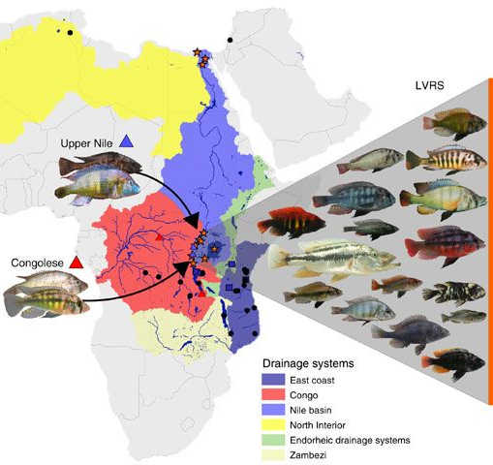
Benefits of hybridisation
Polar bears and grizzlies: potential adaptation to climate change?
Jaguars and lions: lion genes affecting optic nerves -> better vision in jaguars.
Cichlid radiation in Lake Victoria: 700+ species in 150,000 years.
Cichlid radiation. Meier et al. 2017
Notes:
Original article: Meier et al., 2017. Ancient hybridization fuels rapid cichlid fish adapative radiations. Nature Comms 8: 14363
Original article: Figueiro, et al. Genome-wide signatures of complex introgression and adaptation in the big cats. SCIENCE ADVANCES19 JUL 2017 : E1700299
Popular article: www.nature.com/articles/468891a (polars and grizzlies)
Polars and Grizzlies have been interbreeding for 1000s of years. Grizzly mtDNA in Polars and Polar nuclear DNA in Grizzlies.
Substantial interbreeding between 5 big cat (Panthera) lineages, most genetic material introgressed lost over time, but some genes, such as those gained by jaguars from lions have been kept, arguably because they had a functional value.

Slide 8
Insufficient variation
Too little variation is deleterious
Accumulation of errors / maladaptive traits
Inbreeding depression
Low population densities in Pleistocene hominins -> inbreeding
Altai Neanderthal (120,000 ya)
El Sidrón (55,000 ya)
Hybridisation = important source of genetic novelties?
Charles II of Spain, possessor of the ‘Habsburgh jaw’. Suffered mental and physical ill health likely due to generations of inbreeding
Alvarez et al. 2009 PLoS One;
Prüfer, et al., 2014. Nature;
Ríos, et al. 2019. Nature Sci Reps
Notes:
news.nationalgeographic.com/news/2013/12/131218-neanderthal-genome-incest-archaic-ancestor-science/
Recessive disorders, inbreeding depression, inability to adapt to change
Altai Neaderthal from Denisovan cave – parents suggested to be closely related, of the order of ½ siblings or nephew and aunt. Limits of Neanderthal range?
El Sidron – mtDNA shows very little variation and high levels of congenital abnormalities

Slide 9
Hybridisation as an evolutionary mechanism
Fusion of species
Genetic swamping of one species by another
Reinforcing of reproductive isolation between taxa
Transfer of genetic material from one species into another
Origin of completely new species

Slide 10
Hybridisation as an evolutionary mechanism
Fusion of species
Genetic swamping of one species by another
Reinforcing of reproductive isolation between taxa
Transfer of genetic material from one species into another
Origin of completely new species

Slide 11
Hybridisation as an evolutionary mechanism
Fusion of species
Genetic swamping of one species by another
Reinforcing of reproductive isolation between taxa
Transfer of genetic material from one species into another
Origin of completely new species

Slide 12
Hybridisation as an evolutionary mechanism
Fusion of species
Genetic swamping of one species by another
Reinforcing of reproductive isolation between taxa
Transfer of genetic material from one species into another
Origin of completely new species

Slide 13
Hybridisation as an evolutionary mechanism
Fusion of species
Genetic swamping of one species by another
Reinforcing of reproductive isolation between taxa
Transfer of genetic material from one species into another
Origin of completely new species

Slide 14
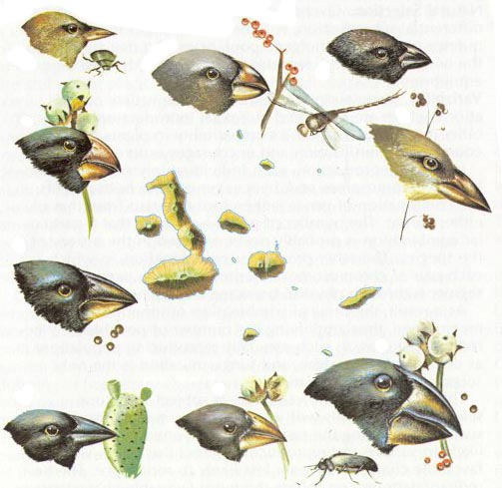
When / when does hybridisation occur in nature?
In zones of contact – “hybrid zones”
Can be stable if hybrids > fitness in habitat of hybrid zone
Range expansion
Adaptive radiations
At the extremes of species’ ranges
Population density low -> mates are rare
Less competition -> reduced selection on hybrids
Following ecological disturbance
Galapagos (Darwin’s) finches, a classic adaptive radiation. Grant & Grant. 1992. Science
Notes:
Grant & Grant, 1992. Hybridization of a bird species. Science: 256,193-197
Various circumstances where genetic novelty, rather than adaptation / specialisation to status quo may be advantageous
After speciation, new species are often incompletely reproductively isolated for millions of years
Some of these may be relevant in the context of human evolution…

Slide 15
Morphological consequences of hybridisation
Cryptic hybrids: Effect on phenotype depends what is introgressed
Heterosis: ‘Hybrid vigour’, often expressed as greater size than either parent
Dysgenesis: Hybrid disfunction
Transgressive segregation: production of extreme phenotypes and great variation
Notes:
Dysgenesis caused by breakdown of coadapted gene complexes due to recombination
Transgressive segregation: Additive effects – intermediates between each parental form. Increases with increasing genetic distance between parents
Increased variation and even transgressive segregation can be beneficial in succeeding in novel environments
Heterosis — hybrid vigor that can result from heterozygote advantage (overdominance) or recombinant hybrid vigor

Slide 16
Morphological consequences of hybridisation
Cryptic hybrids: Effect on phenotype depends what is introgressed
Heterosis: ‘Hybrid vigour’, often expressed as greater size than either parent
Dysgenesis: Hybrid disfunction
Transgressive segregation: production of extreme phenotypes and great variation
Notes:
Dysgenesis caused by breakdown of coadapted gene complexes due to recombination
Transgressive segregation: Additive effects – intermediates between each parental form. Increases with increasing genetic distance between parents
Increased variation and even transgressive segregation can be beneficial in succeeding in novel environments
Heterosis — hybrid vigor that can result from heterozygote advantage (overdominance) or recombinant hybrid vigor

Slide 17
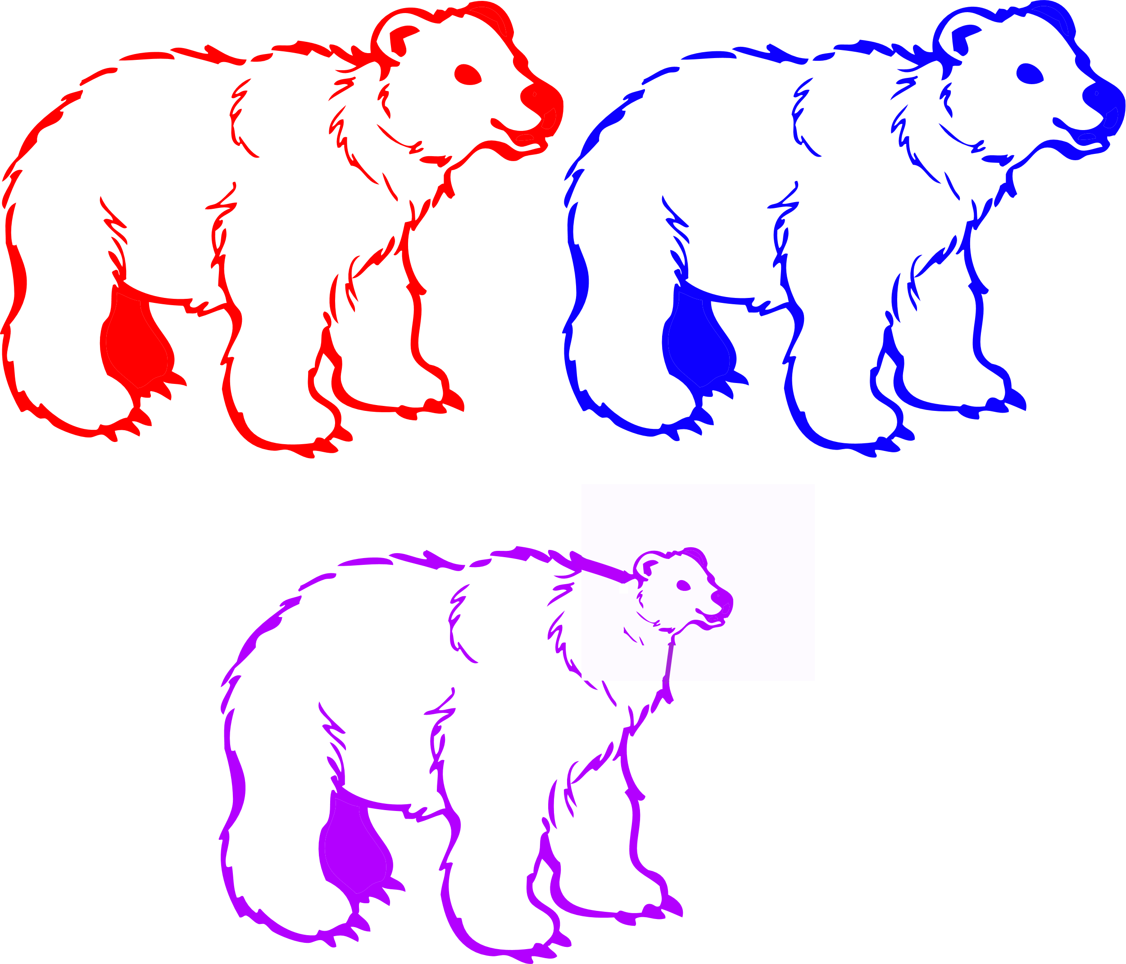
Morphological consequences of hybridisation
Cryptic hybrids: Effect on phenotype depends what is introgressed
Heterosis: ‘Hybrid vigour’, often expressed as greater size than either parent
Dysgenesis: Hybrid disfunction
Transgressive segregation: production of extreme phenotypes and great variation
Notes:
Dysgenesis caused by breakdown of coadapted gene complexes due to recombination
Transgressive segregation: Additive effects – intermediates between each parental form. Increases with increasing genetic distance between parents
Increased variation and even transgressive segregation can be beneficial in succeeding in novel environments
Heterosis — hybrid vigor that can result from heterozygote advantage (overdominance) or recombinant hybrid vigor

Slide 18
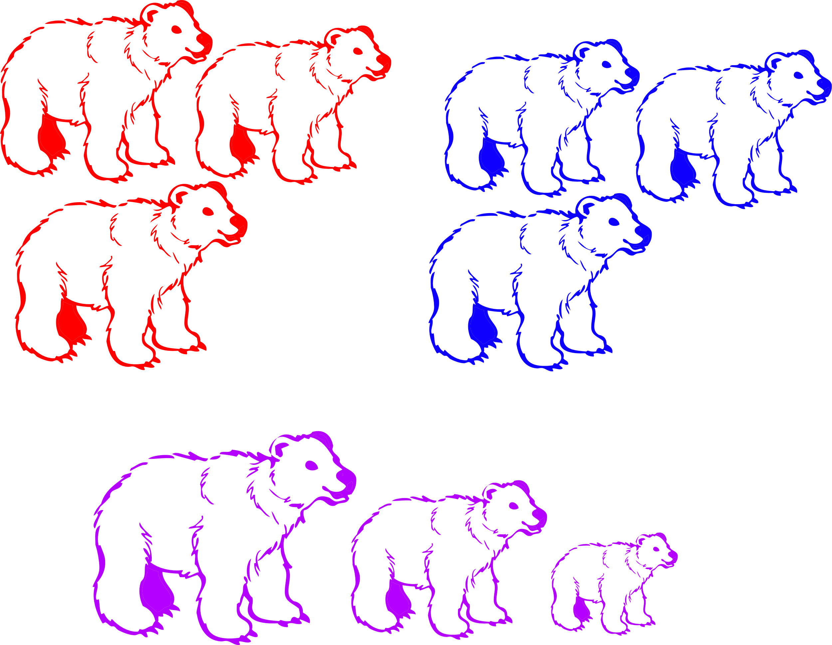
Morphological consequences of hybridisation
Cryptic hybrids: Effect on phenotype depends what is introgressed
Heterosis: ‘Hybrid vigour’, often expressed as greater size than either parent
Dysgenesis: Hybrid disfunction
Transgressive segregation: production of extreme phenotypes and great variation
Notes:
Dysgenesis caused by breakdown of coadapted gene complexes due to recombination
Transgressive segregation: Additive effects – intermediates between each parental form. Increases with increasing genetic distance between parents
Increased variation and even transgressive segregation can be beneficial in succeeding in novel environments
Heterosis — hybrid vigor that can result from heterozygote advantage (overdominance) or recombinant hybrid vigor

Slide 19
How common is hybridisation in nature?
Rare per individual, but common per species
25% vascular plants
~10% birds, butterflies and mammals
Some groups particularly prone to hybridisation:
25% British duck species
100% British game birds (grouse and allies)
25% Passion flower butterflies
Heliconius butterflies
Notes:
Mallet, 2005. Hybridization as an invasion of the genome. Trends in Ecology and Evolution 20: 229-237
Mavarez et al. 206. Speciation by hybridization in Heliconius butterflies. Nature 441: 868-871
Ascertainment bias – easier to recognise in brightly coloured taxa e.g., ducks / butterflies
Compatibility “Reasonably, but relatively coarsely clock-like” (Mallet, 2005:233) depending on behavioural, genetic, and developmental factors

Slide 20
Useful readings
Peer-reviewed articles
Seehausen, 2004. Hybridization and adaptive radiation. Trends in ecology and evolution (TREE): 19: 198-207
Meier et al., 2017. Ancient hybridization fuels rapid cichlid fish adapative radiations. Nature Comms 8: 14363
Figueiro, et al. Genome-wide signatures of complex introgression and adaptation in the big cats. SCIENCE ADVANCES19 JUL 2017 : E1700299
Grant & Grant, 1992. Hybridization of a bird species. Science: 256,193-197
Mallet, 2005. Hybridization as an invasion of the genome. Trends in Ecology and Evolution 20: 229-237
Mavarez et al. 206. Speciation by hybridization in Heliconius butterflies. Nature 441: 868-871
Popular articles
www.nature.com/scitable/topicpage/hybrid-incompatibility-and-speciation-820
www.sciencenews.org/article/hybrids-reveal-barriers-successful-mating-between-species
www.nature.com/scitable/topicpage/hybrid-incompatibility-and-speciation-820
www.sciencenews.org/article/hybrids-reveal-barriers-successful-mating-between-species
www.quantamagazine.org/interspecies-hybrids-play-a-vital-role-in-evolution-20170824/
www.nature.com/articles/468891a (polars and grizzlies)

